Slide 1
Measurement of central Tendency
By: Priyanka Chaudhari

Slide 2
What is Measurement of Central Tendency?
The measurement of central tendency is defined as the number used to represent the center or middle of a set of data values.
The goal of central tendency is to find the single score that is most typical or most representative of the entire group.

Slide 3
What are 3 Central Tendency measures?
The 3 most common measures of central tendency are the mean, median and mode.
The mean is the sum of all values divided by the total number of values.
The median is the middle number in an ordered data set.
The mode is the most frequent value.

Slide 4
Standard deviation
The standard deviation is a measure of the amount of variation or dispersion of a set of values.
A low standard deviation indicates that the values tend to be close to the mean (or the expected value) of the set.
A high standard deviation indicates that the values are spread out over a wider range.
The variance is a measure of variability. It is calculated by taking the average of squared deviations from the mean.

Slide 5
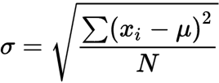
Standard deviation formula
σ = population standard deviation
N= the size of the population
X_{i} = each value from the population
μ = the population mean

Slide 6
Population and Sample
A population is the entire group that you want to draw conclusions about. In research, a population doesn't always refer to people.
A sample is the specific group that you will collect data from. The size of the sample is always less than the total size of the population.

Slide 7
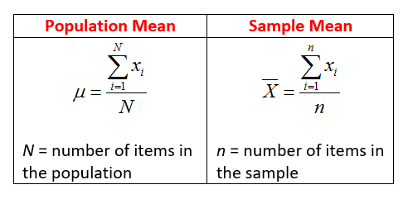
Population Mean & Sample Mean
Population Mean is the mean of all the values in the population. Sample Mean is the mean of all the values in the sample data

Slide 8
Find Mean, median, mode and standard deviation for each data set.
a.) 7,11,16, 14, 11, 13, 19, 13,13
Mean= 13 Median= 11 Mode= 13 S.D=3.16

Slide 9
b.) 16, 15, 16, 17, 19, 12, 14, 9
Mean= 14.75 Median= 18 Mode= 16 S.D=2.904

Slide 10
c.) 27, 66, 24, 81, 50, 40, 74, 81, 97
Mean= 51.88 Median= 45 S.D=27.96

